Slide 1


Essentials for Data Visualization
SIT112 | Intro to Data Science & AI
Lecture Week 3
Dr. Fatima Ansarizadeh
Lecturer
School of Information Technology, Deakin University
Email: f.ansarizadeh@deakin.edu.au

Slide 2
Objectives
Use the Pandas plot() method to create: line plot, area plot, scatter plot, bar plot, histogram, density plot, box plot, pie plot
Use the parameters of the Pandas plot() method to enhance a plot in these ways: add a title, x and y labels, and grid lines, rotate the tick labels, set the x- and y-axis limits
Use the parameters of the Pandas plot() method to create a plot that has subplots.
Chain the Pandas plot() method to methods that prepare the data for the plot() method.
Use the Seaborn methods to create: line plot, scatter plot, bar plot, box plot, histogram, KDE plot, ECDF plot
Use Seaborn parameters to create a plot with subplots.
Use the methods of the Axes object to enhance a plot: add a title and the labels for the x- and y-axis, set the ticks for a plot, set the x and y limits, add grid lines, annotate a plot, set the colour palette

Slide 3
Why Data Visualization?
Understand Your Data More Easily.
See the Relationships Between Variables.
Spot Unusual Datapoints Like Outliers.
Notes:
Understand the data Get a quick overview of the dataset.
See how values are distributed.
Identify the range and spread of the data.
Find relationships Discover whether two or more variables are related.
Detect positive, negative, or no correlation.
Example: Does study time increase exam scores?
Detect outliers Identify unusually high or low values.
Outliers may indicate:
Data entry errors
Measurement errors
Rare but important observations
Identify patterns and trends. Observe trends over time.
Detect seasonal patterns.
Find clusters or groups of similar observations.
Compare categories Compare averages, counts, or distributions between groups.
Example: Compare salaries across different departments.
Communicate insights Visuals are easier to understand than tables of numbers.
They help explain findings to technical and non-technical audiences.

Slide 4






Data Visualization Libraries in Python
Notes:
These Python data visualization tools help you turn raw numbers into visual charts.
While Pandas and Matplotlib offer foundational graphing, Seaborn builds on them for statistics.
Bokeh/bokei/, Vega-Altair/vega e tar/, and Plotly are built for dynamic, web-based, and interactive dashboards.

Slide 5

Data Visualization with Pandas

Slide 6
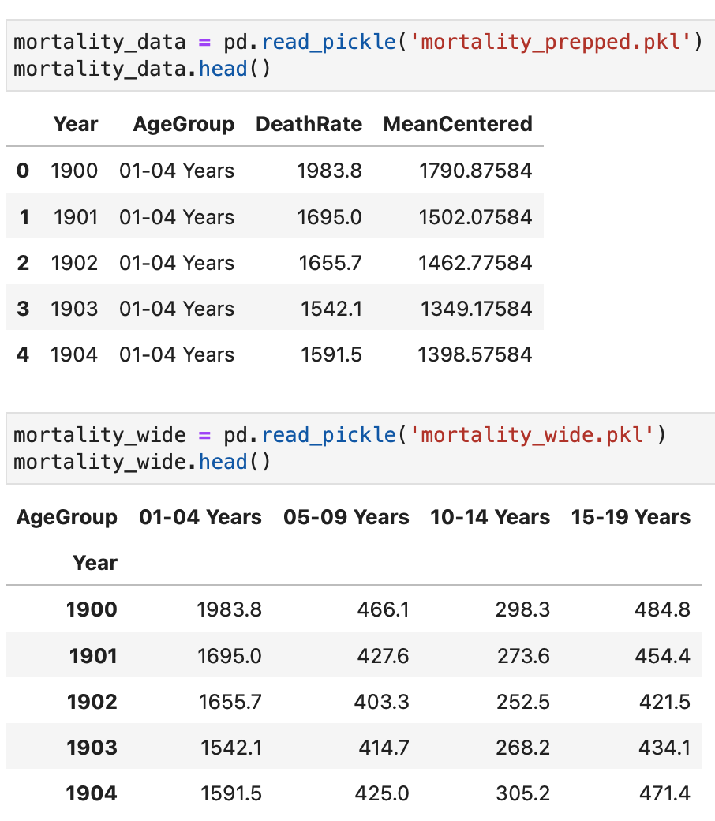
Get the Data: Long vs Wide
Notes:
Prepoccesed and wide
To create a wide table from a long-format table in pandas, you reshape the data by pivoting unique row values into individual column headers.
We make wide tables in pandas primarily for human readability, executive reporting, and horizontal data comparisons.
While computer algorithms and visualisation libraries prefer long (tidy) formats,
wide tables present data in a familiar, spreadsheet-like layout where each unique entity occupies exactly one row.

Slide 7
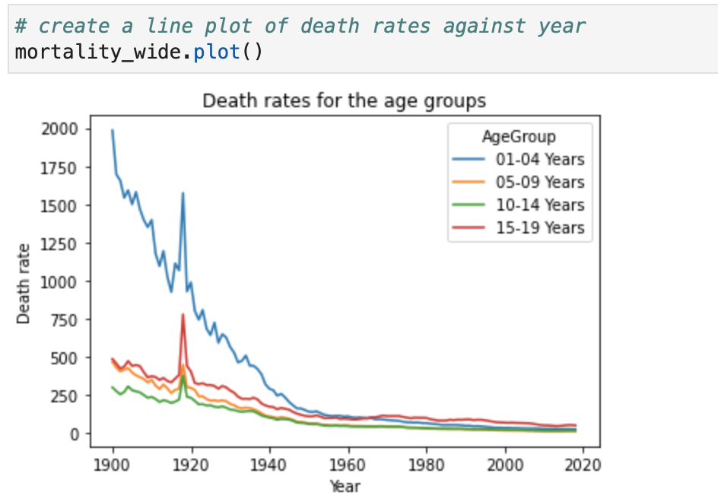
Line Plot of the Wide Data
Useful for showing trends and changes in data over time.
They are also useful for showing the relationship between two variables.

Slide 8
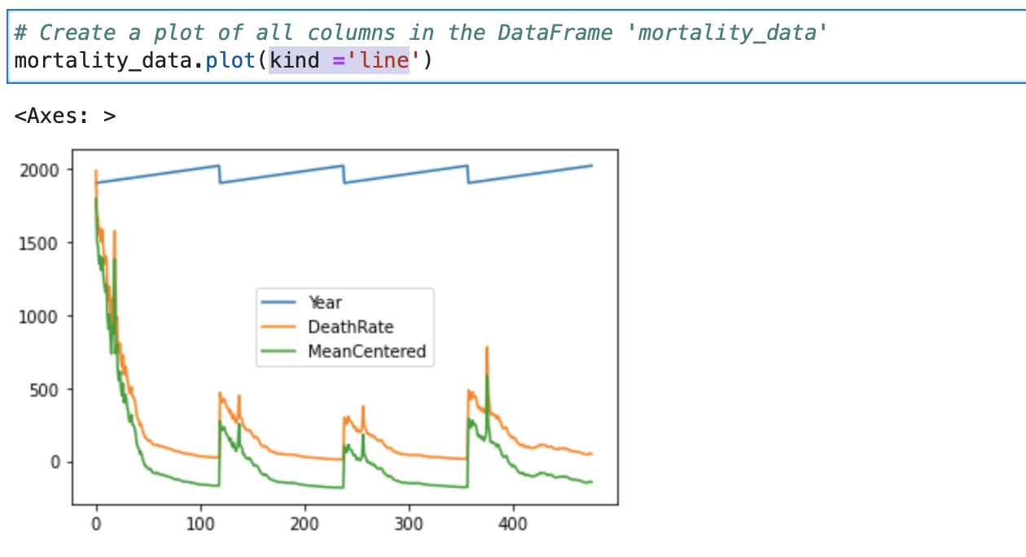
Line Plot of All Columns
Notes:
Why is Long Format Popular?
Long format works much better with visualization libraries like Seaborn and Plotly Express, because they can use a categorical column to create separate lines or bars.
Wide format → Pandas can often figure out what to plot automatically.
Long format → You tell the plotting function which column contains the values (y) and which column defines the groups

Slide 9
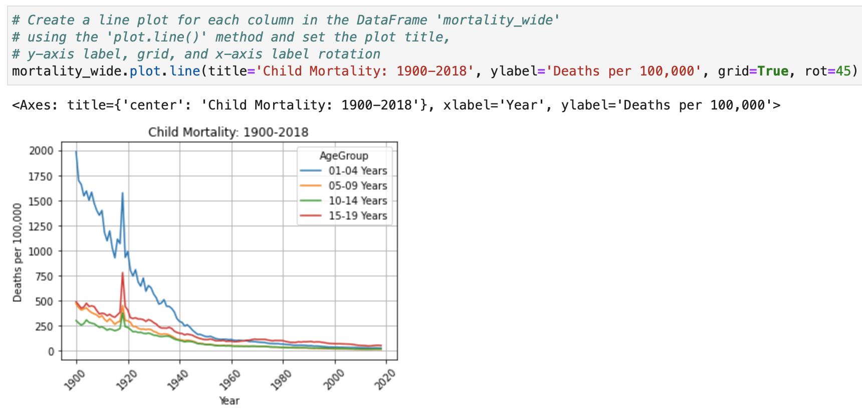
Line Plot – Improve the Appearance
Notes:
In pandas, there is no functional difference between df.plot() and df.plot.line(); both methods generate identical line plots.
The choice between them comes down to syntax style, code autocomplete behavior, and how you prefer to switch between different visualization types.
df.plot(): This is the general plotting wrapper. Because its kind parameter defaults to 'line', calling it with no arguments automatically draws a line graph. You change the chart type by passing a string, like df.plot(kind='bar’).
df.plot.line(): This calls the specific line plotting method directly from the PlotAccessor object. To change chart types using this syntax style, you switch the trailing method name entirely, such as df.plot.bar().

Slide 10
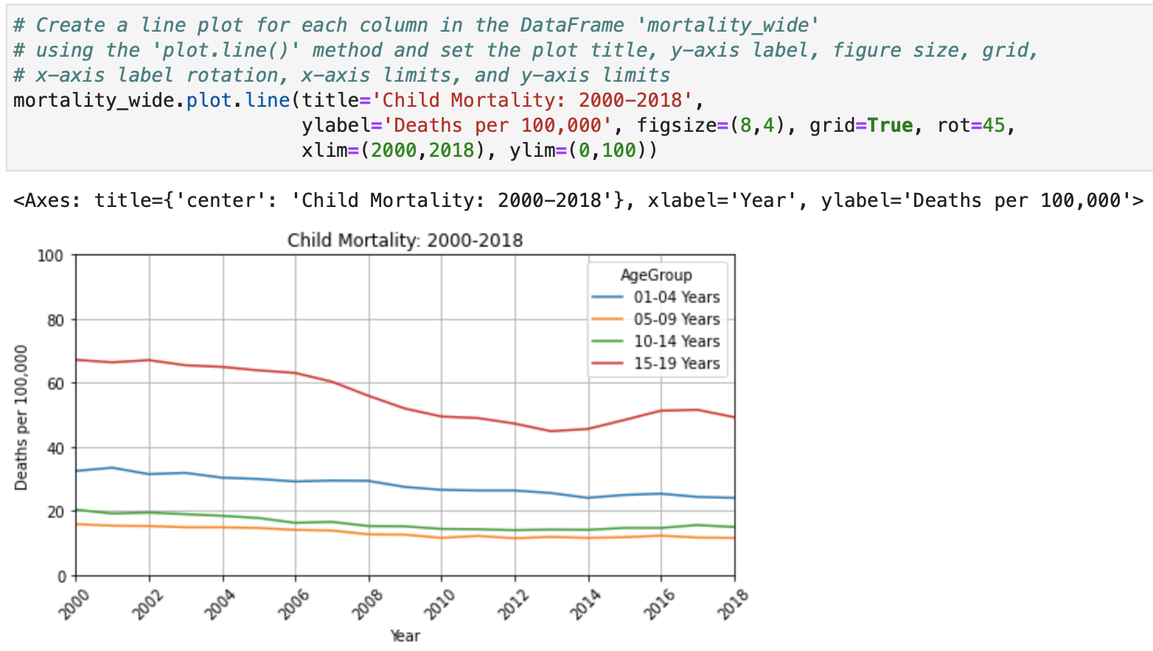
Line Plot – Improve the Appearance
Notes:
Zoomed in in previous plot choose xlim and ylim

Slide 11

How to rotate the y-axis label?
Ask ChatGPT ☺

Slide 12
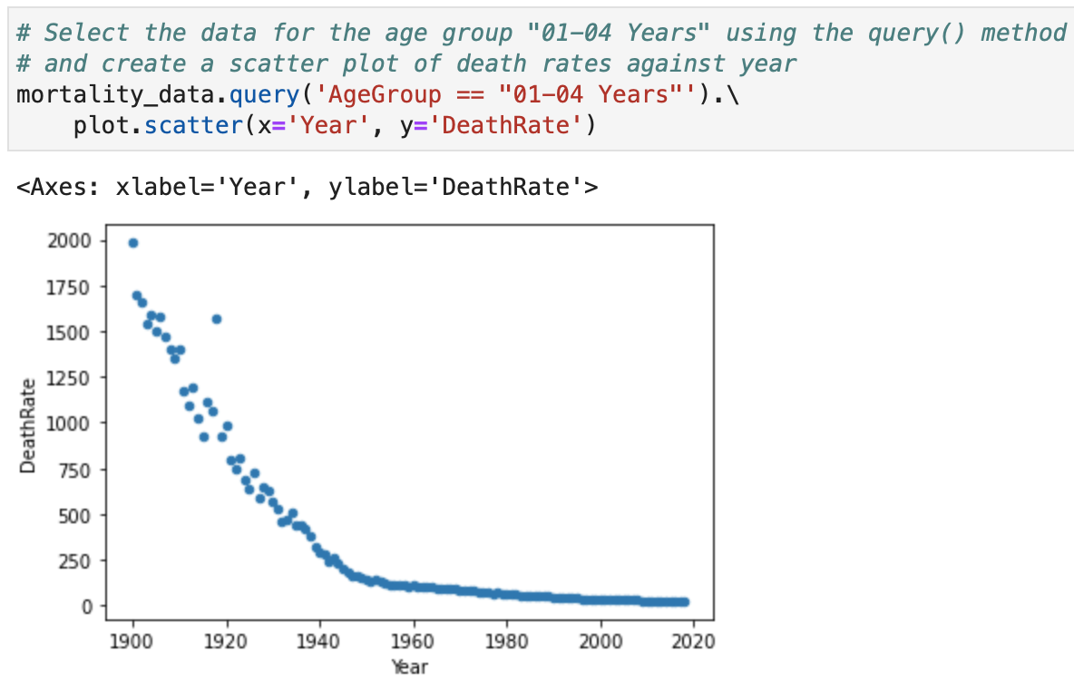
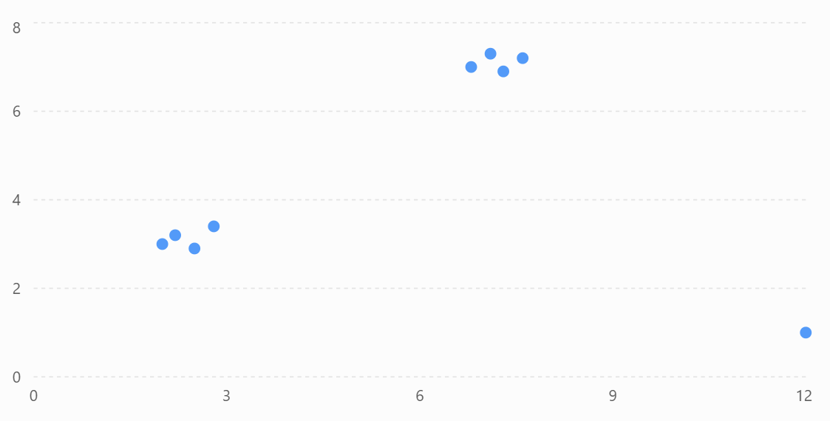
Scatter Plot
✔ Used to compare two numerical variables.
✔ Each point represents one observation (one row).
✔ Helps identify trends, correlation, clusters, and outliers.
✔ Best suited for continuous numerical data.
Notes:
Displays the relationship between two numerical variables. Each observation in the dataset is represented as a single point.
The x-axis represents one numeric variable.
The y-axis represents another numeric variable.
Each dot corresponds to one row in the DataFrame.
Scatter plots help you identify:
Relationships (positive, negative, or no correlation)
Trends
Clusters
Outliers
Key Points for Students
✔ Used to compare two numerical variables.
✔ Each point represents one observation (one row).
✔ Helps identify correlation, clusters, and outliers.
✔ Best suited for continuous numerical data.
Why are scatter plots less suitable for long tables?
This is a wide table because each variable has its own column.

Slide 13
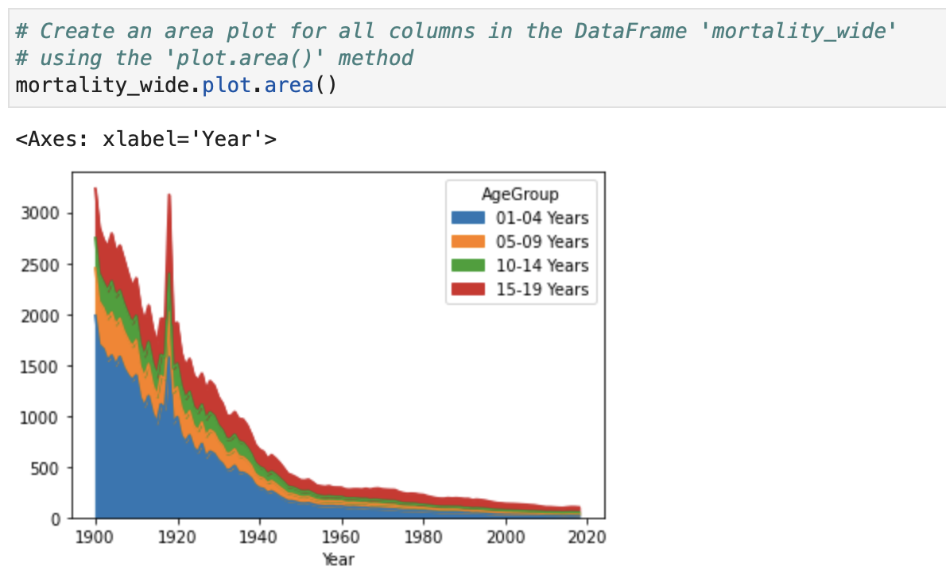
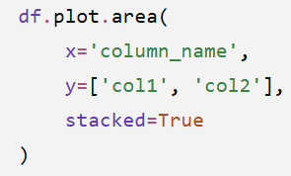
Area Plot
Useful for showing changes in data over time or comparing data across different groups.
Often used when the volume or total magnitude of the data is as important as the trend itself.
Notes:
A line plot shows how values change; an area plot shows how values change while emphasizing the size of those values.
An area plot is a type of line plot where the area below the line is filled with colour. It is useful for showing:
Trends over time
Changes in magnitude
Cumulative contributions
Comparisons between multiple categories
Comparing Multiple Categories (Stacked Area Plot)
A common use of area plots is to show how different categories contribute to a total.
stacked=TrueStacks areas on top of each other
alphaControls transparency

Slide 14
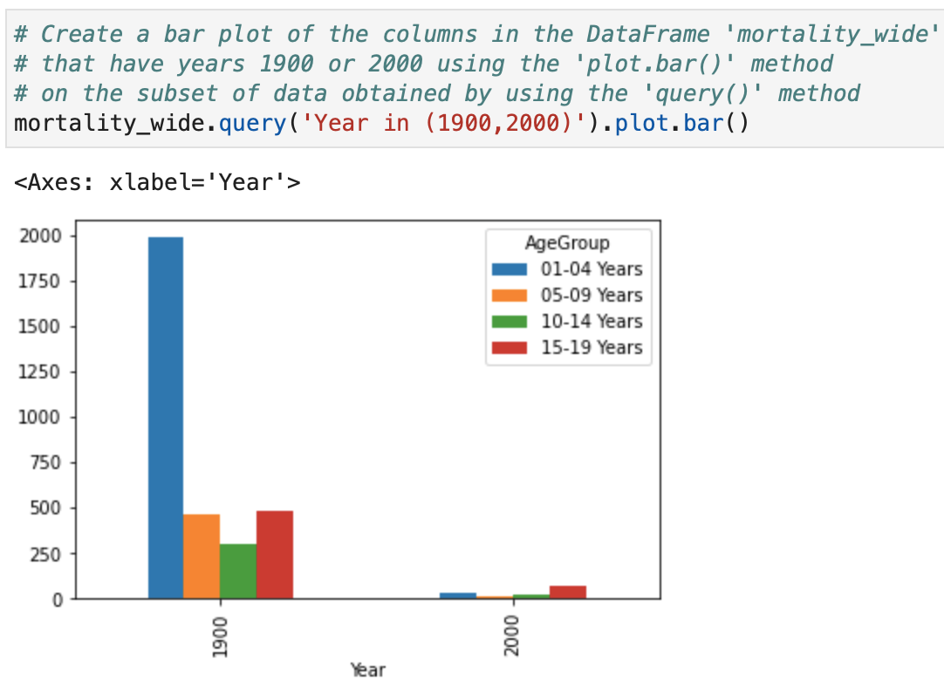
Bar Plot
Particularly useful for showing changes in data over time or comparing data across different groups.
The height or length of each bar shows the value of a variable.
Notes:
A bar plot (bar chart) represents data using rectangular bars, where the height or length of each bar shows the value of a variable.
Bar plots are useful for:
Comparing values across different categories
Showing rankings
Comparing groups or classes
Displaying frequency/count data
Horizontal Bar Plot: df.plot.barh()
Multiple Categories (Grouped Bar Plot)
Stacked Bar Plot
A stacked bar shows how different parts contribute to a total.

Slide 15
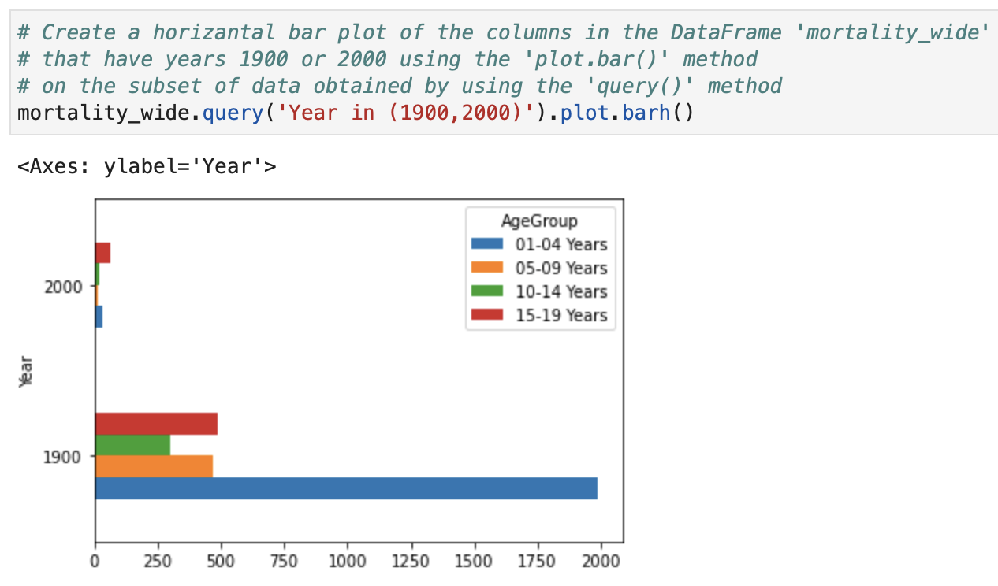
Bar Plot - Horizontal
Notes:
Use a bar plot when you want to compare values between categories. Use a scatter plot when you want to investigate relationships between numerical variables.

Slide 16
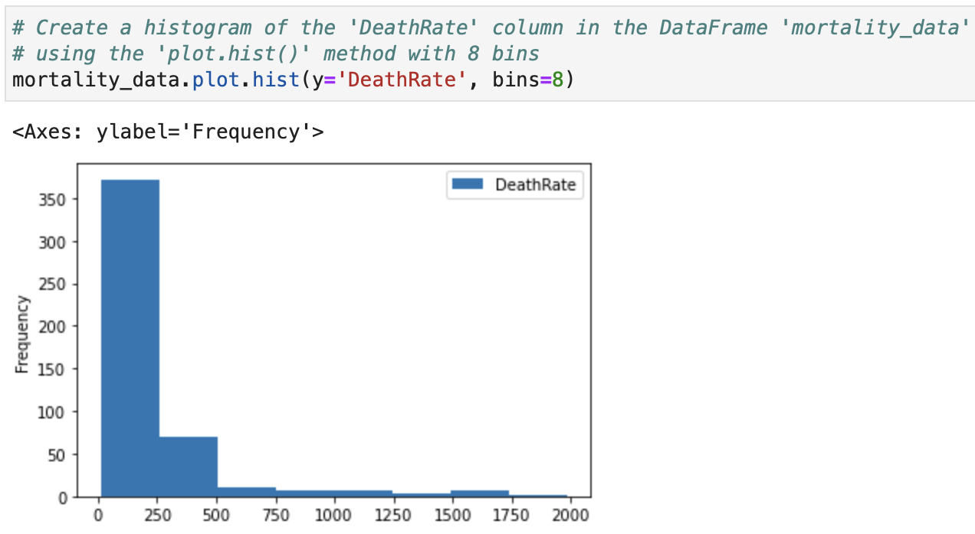
Histogram
Useful for showing the distribution of data.
Particularly useful for identifying the range and frequency of values in a dataset.
The x-axis represents the values (or ranges/bins) of the variable.
The y-axis represents the frequency (count) of observations in each range.
Notes:
Although both use bars, they represent different types of data and answer different questions.
A bar chart compares different categories: How many students are enrolled in each course?
Histogram Example
How are students' exam scores distributed?
A histogram groups values into ranges (bins):

Slide 17
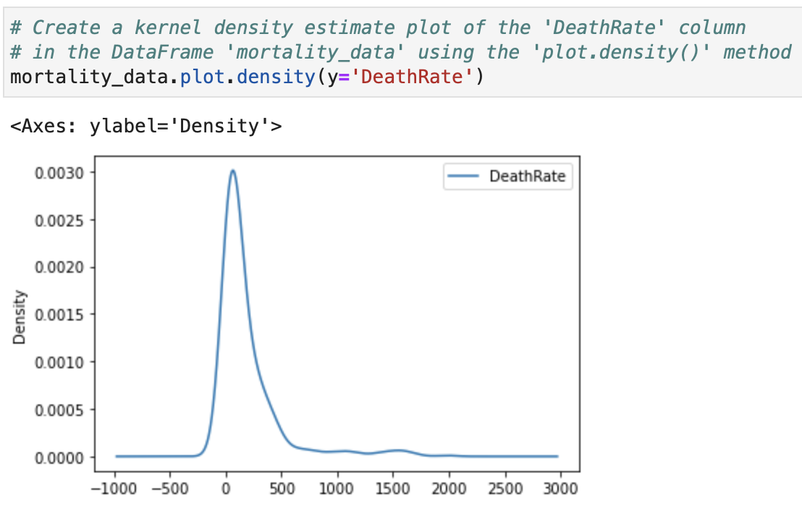
Density Plot
To visualise the distribution of a continuous random variable.
It is similar to a histogram, but instead of using bars and bins, it uses a continuous smooth curve.
It allows us to see the shape of the distribution, including its central tendency, spread, and skewness.
Notes:
A density plot (also called a Kernel Density Estimate plot - KDE) shows the distribution of numerical data by displaying a smooth curve that represents where values are concentrated.
It is similar to a histogram, but instead of using bars and bins, it uses a continuous smooth curve.
A density plot helps you understand:
Where most observations are concentrated
The shape of the distribution
Whether data is symmetric or skewed
Whether there are multiple peaks (multiple groups)
Shows probability distribution
The curve shows:
The highest point → where scores are most common
The width of the curve → spread of scores
The tails → rare values

Slide 18
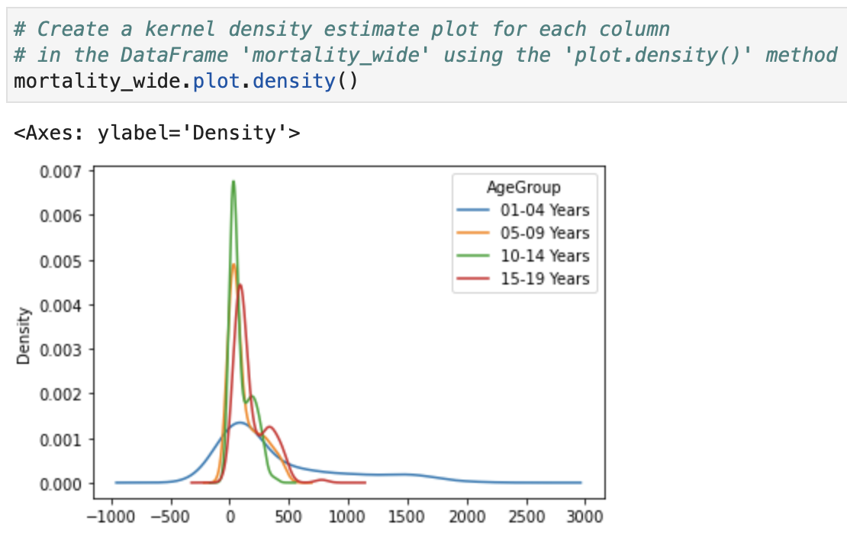
Density Plot (Cont.)
Also useful for comparing the distributions of different groups or variables; by overlaying multiple density plots, we can see how their distributions differ.
Notes:
By overlaying multiple density plots on the same graph, we can visually compare how their distributions differ, including differences in their centre, spread, and shape.
When the density curves are overlaid:
A curve shifted to the right indicates higher values.
A wider curve indicates more variation in the data.
A narrower curve indicates more consistent values.
The peak of the curve shows where values are most concentrated.
Overlaying density plots is useful for comparing:
Exam scores between different classes
Age distributions across populations
Income distributions between regions
Model performance metrics
Feature distributions in machine learning datasets

Slide 19
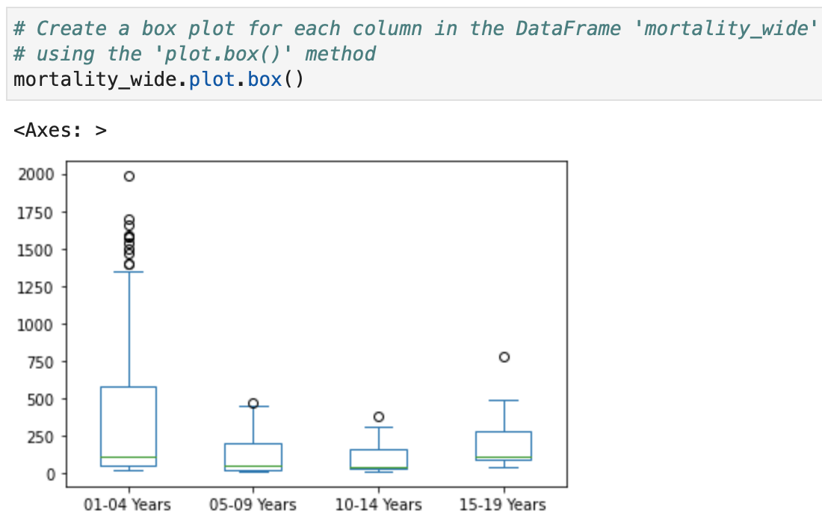
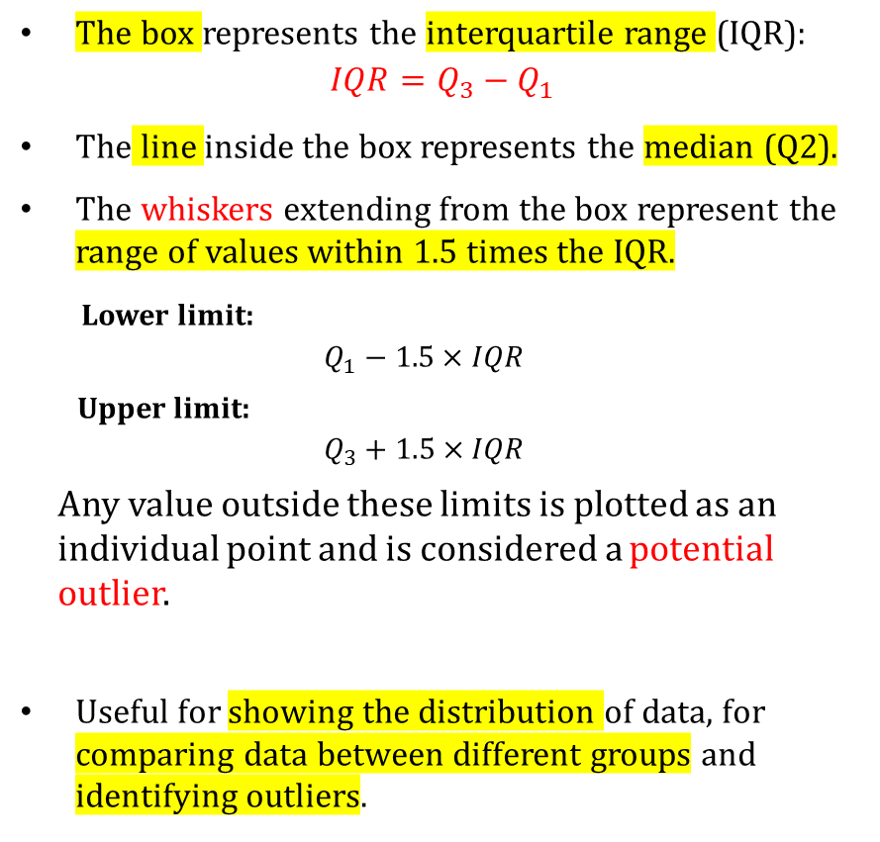
Box Plot
The box represents the interquartile range (IQR):
$$IQR=Q_{3}−Q_{1}$$
The line inside the box represents the median (Q2).
The whiskers extending from the box represent the range of values within 1.5 times the IQR.
Lower limit:
$$Q_{1}−1.5×IQR$$
Upper limit:
$$Q_{3}+1.5×IQR$$
Any value outside these limits is plotted as an individual point and is considered a potential outlier.
Useful for showing the distribution of data, for comparing data between different groups and identifying outliers.
Notes:
A graphical summary of the distribution of numerical data. It displays the centre, spread, and potential outliers of a dataset.
Whiskers -> Range of typical values
Points outside whiskers -> Potential outliers
In a box plot, points shown outside the whiskers are called potential outliers, not necessarily true outliers.
This is because the box plot uses a simple statistical rule to flag unusual observations. These points should be investigated, not automatically removed.
Lower limit:
$$Q_{1}−1.5×IQR$$
Upper limit:
$$Q_{3}+1.5×IQR$$
where
$$IQR=Q_{3}−Q_{1}$$
Any value outside these limits is plotted as an individual point and is considered a potential outlier.
A box plot identifies potential outliers using the 1.5 × IQR rule. However, a point outside the whiskers is not automatically a true outlier or an error. It should be investigated to determine whether it is due to a recording error, a measurement error, or a genuine but unusual observation.
How do we determine whether it is a real outlier?
After identifying a potential outlier, ask the following questions:
1. Is it a data entry error?
Example:
A student's exam score is recorded as:
850
instead of
85
This is a data entry error and should be corrected.
2. Is it a measurement error?
Example:
A patient's body temperature is recorded as
420°C
Clearly impossible.
This is likely due to faulty equipment or incorrect recording.
3. Is it a valid but rare observation?
Example:
Suppose the data represent annual salaries.
Most salaries are:
$60k – $120k
One person earns
$2 million
Although unusual, it may be correct.
This is a true outlier and may contain important information.
4. Does it belong to a different population?
Example:
You are analysing adult heights.
One observation is
120 cm
If it belongs to a child accidentally included in the dataset, it should not be analysed with the adult data.
5. Does the outlier affect the analysis?
Sometimes a valid outlier can strongly influence statistical results or machine learning models.
Consider:
keeping it,
transforming the data (e.g., using a log transformation),
using robust statistics (such as the median instead of the mean), or
analysing it separately.
The choice depends on the goal of the analysis.
Summary
Situation
Action
Data entry errorCorrect or remove
Measurement errorCorrect or remove
Valid rare observationKeep and report
Different populationInvestigate and possibly exclude
Influences analysisConsider robust methods or transformations

Slide 20
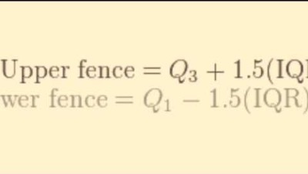
Interquartile Range Song? ☺

Slide 21

Challenge: Can you compose a song for Data Science/AI ? :)

Slide 22
AI-Genereated Lyrics
(Verse 1)
We start with a question, something to solve,
Dig through the data, let the mystery resolve.
Clean it, preprocess, until it's refined,
Seeking the patterns that are hidden inside.
(Chorus)
Data, oh data, tell us your truth,
Algorithms humming, they're on the move.
Models and training, accuracy's key,
Predictions and insights, set the knowledge free.

Slide 23
AI-Genereated Lyrics (Cont.)
(Verse 2)
Visualize the findings in a graph or a chart,
Communicate results, that's the real art.
Iterate, improve, let's run it again,
Data science and I, on this journey we embark!
(Bridge)
Machine learning, stats, and AI combine,
Turning raw numbers into something divine.
From Python to R, tools in our hand,
We're data detectives, making a stand.

Slide 24
AI-Genereated Lyrics
Data, oh data, tell us your truth,
Algorithms humming, they're on the move.
Models and training, accuracy's key,
Predictions and insights, set the knowledge free.
(Outro)
So here's to the data, our treasure trove,
In a world of numbers, there's always more to know.
Keep querying, coding, exploring the unseen,
Data science and I, a formidable team.

Slide 25
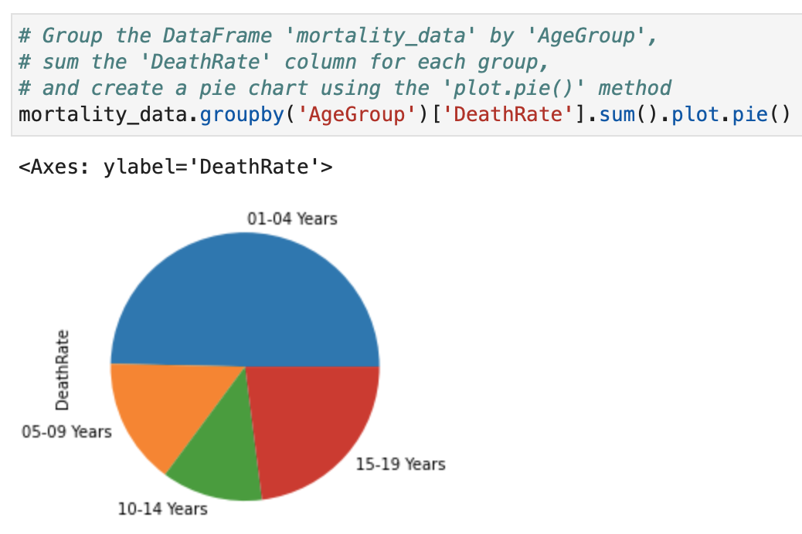
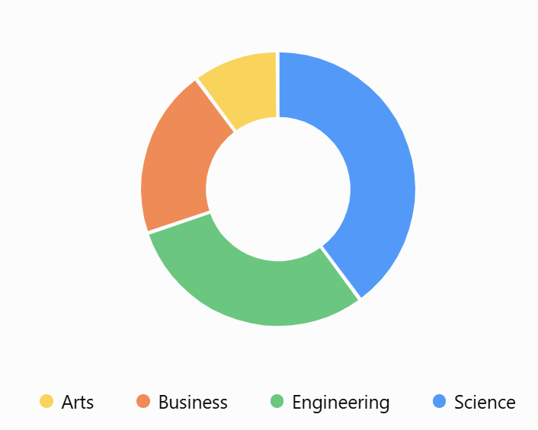
Pie Chart
Displays the relative sizes of different categories of a whole as slices of a pie.
Pie charts can be less effective than other types of charts when trying to display a large amount of data or when the categories are not easily distinguishable.
Use a pie chart when:
You want to show parts of a whole.
The categories add up to 100%.
There are only a few categories (typically 3–6).
Notes:
A pie chart is a circular chart divided into slices, where each slice represents a proportion or percentage of the whole.
Pie charts are useful for showing part-to-whole relationships when there are only a few categories.
Use a pie chart when:
You want to show parts of a whole.
The categories add up to 100%.
There are only a few categories (typically 3–6).
Each slice represents a category, and its size is proportional to its percentage or share of the total. It is most effective when there are only a few categories and the goal is to emphasize proportions rather than exact comparisons.

Slide 26
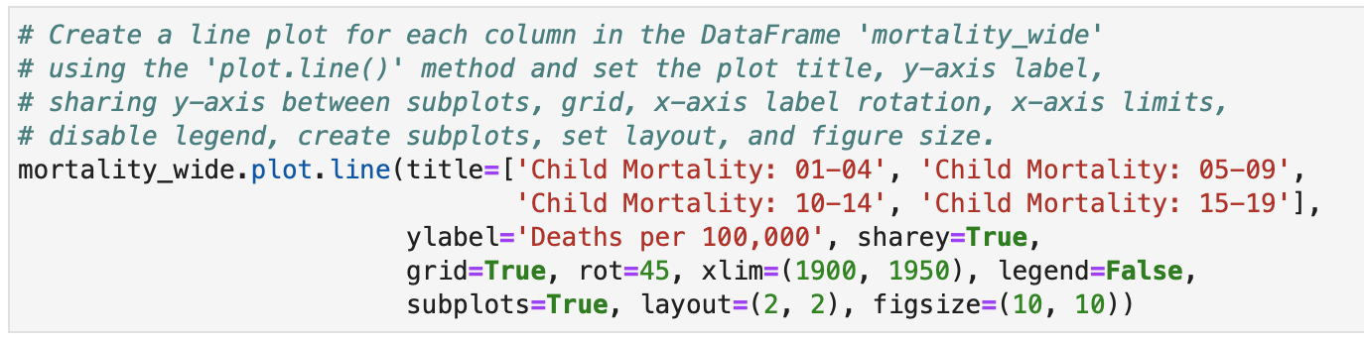
Subplots
subplots=True → Draw one plot for each column.
layout=(2, 2)
2 rows
2 columns
figsize=(10, 10)
size of the entire figure:
Width = 10 inches
Height = 10 inches
Notes:
Layout: Arrangement of subplots
title
Adds a title to the plot. When using subplots=True, provide a list of titles (one for each subplot).
sharey=True
Uses the same y-axis scale for all subplots.
Makes it easier to compare values across different age groups.
xlim=(1900, 1950)
Sets the range of the x-axis.
Only data between 1900 and 1950 are displayed.
rot=45
Rotates the x-axis tick labels by 45 degrees.
Prevents labels from overlapping and improves readability.
grid=True
Displays grid lines.
Improves readability and helps estimate values.
sharey=False
each subplot gets its own scale.
When using only Pandas plot.line(), the rot parameter applies to the x-axis labels only. There is no direct yrot parameter in pandas.plot.line().

Slide 27
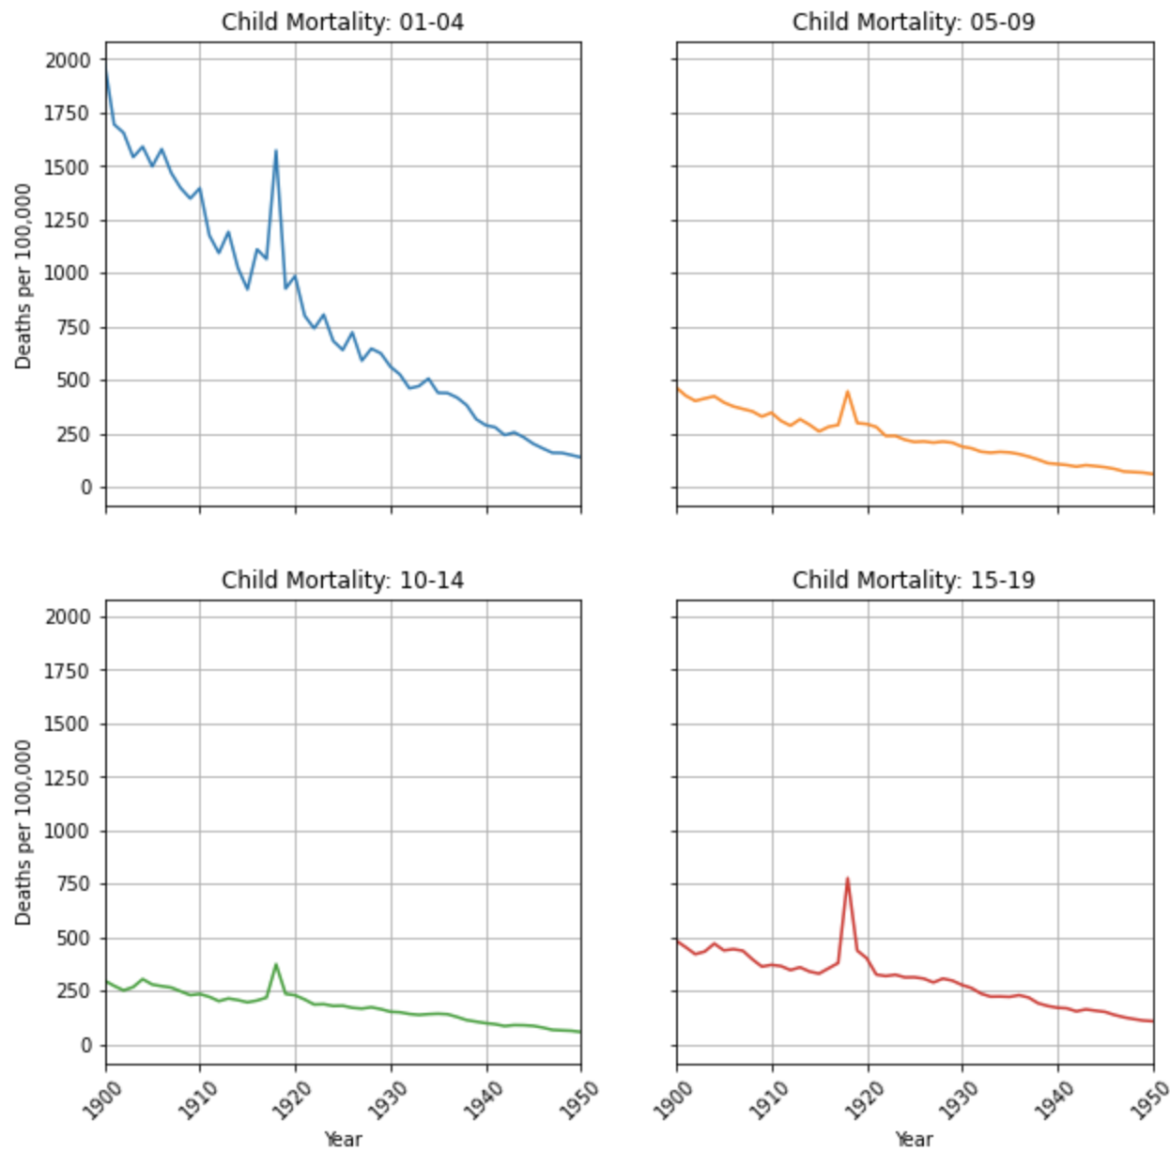
Subplots (Cont.)

Slide 28
How to change the units of measurement in figsize?
In the figsize parameter of the plot() function, the units of measurement are indeed inches by default. However, it is possible to specify a different unit of measurement by using a string that specifies the units. How?
Ask ChatGPT ☺

Slide 29
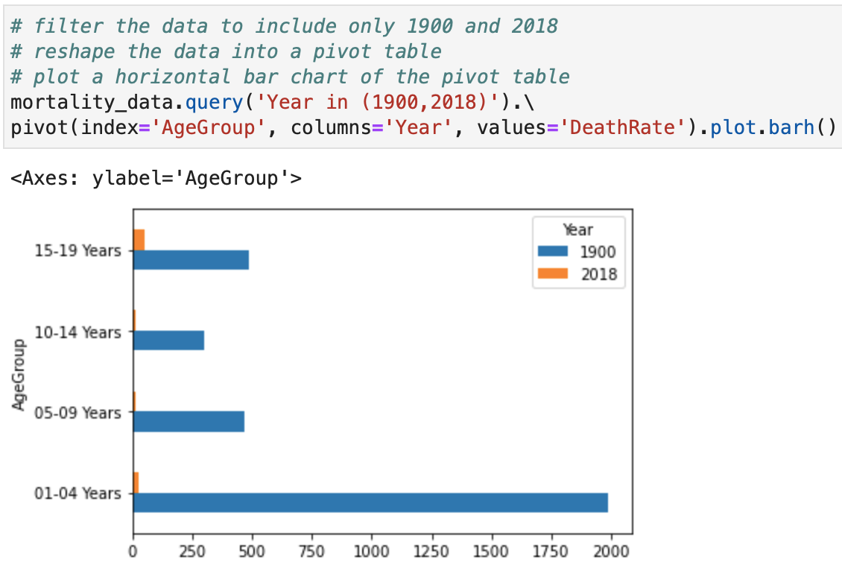
Chaining

Slide 30
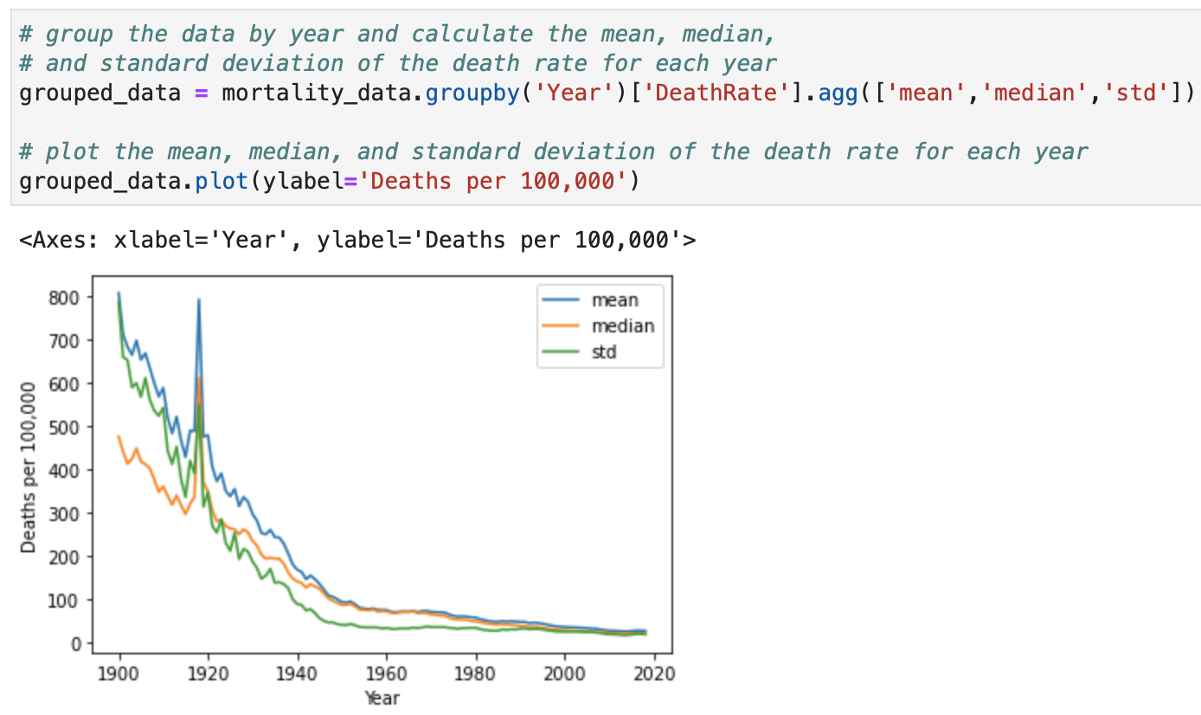
Chaining (Cont.)

Slide 31
Data Visualization with Seaborn

Slide 32
Imports

Slide 33
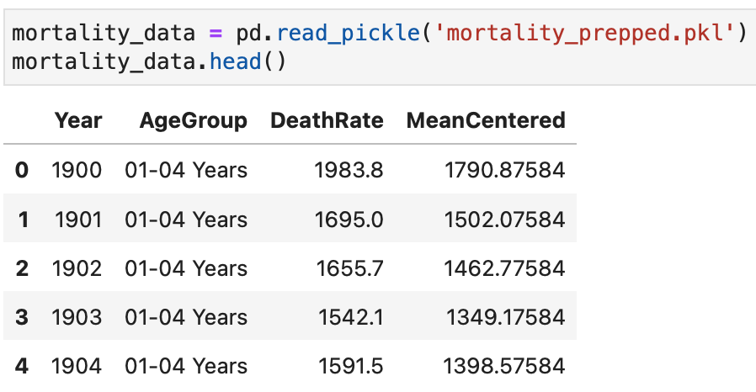
Get the Data

Slide 34
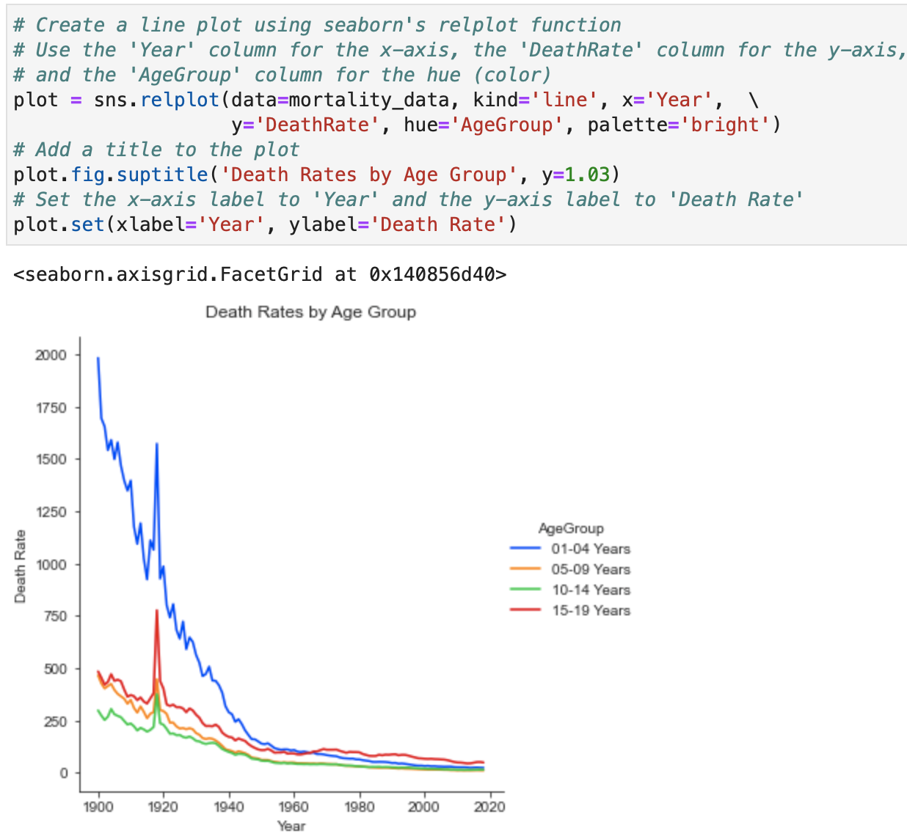
Line Plot
Seaborn's relplot() is used to explore relationships among variables. It creates scatter plots or line plots and allows additional dimensions to be represented using hue (colour -encoding), size, marker style, and multiple panels (row/col).
Seaborn has several built-in palettes that can be used to customise the colour of a plot:
Deep, muted, pastel, bright, dark, colorblind
Notes:
relplot() in Seaborn is a figure-level function used to create relational plots. It helps visualize the relationship between two or more variables.
It can create two main types of plots:
Scatter plot (default)
Line plot
data
Specifies the DataFrame.
x → independent variable y → dependent variable
hue (Colour Encoding)
hue adds colour based on a categorical variable.
size
Changes the size of points based on another variable
Larger bubbles represent larger populations.
style
Uses different markers for categories
Example:
Male ●
Female ▲
kind
Controls the type of plot.
Scatter plot (default)
Faceting with col and row
One powerful feature of relplot() is creating multiple plots automatically

Slide 35
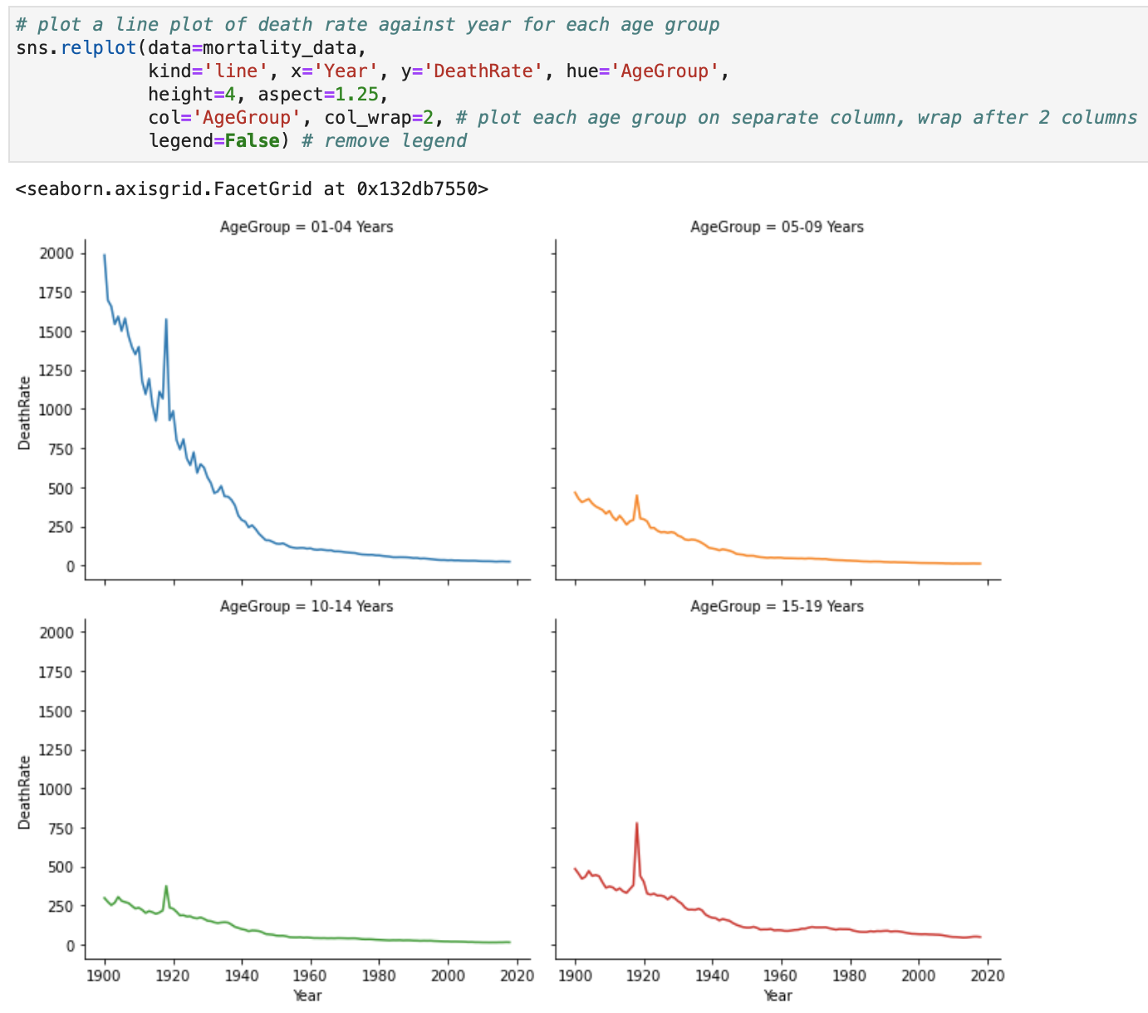
Subplot

Slide 36
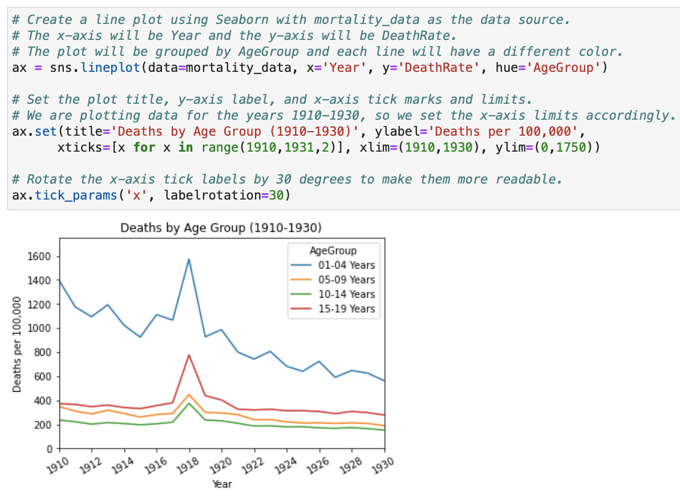
Set the ticks, x limits, and y limits
Notes:
In Pandas plotting, the concepts of axes-level and figure-level functions come mainly from Matplotlib and Seaborn, but they are also important when using DataFrame.plot() in Pandas.
The easiest way to understand them is:
Figure = the whole canvas (the entire output area)
Axes = an individual plot inside that canvas
A figure-level function controls the entire figure and can create multiple axes automatically. Because relplot() creates multiple subplots, it returns a FacetGrid object, not a single Axes.
fig controls the overall figure: while ax controls the individual plot:

Slide 37
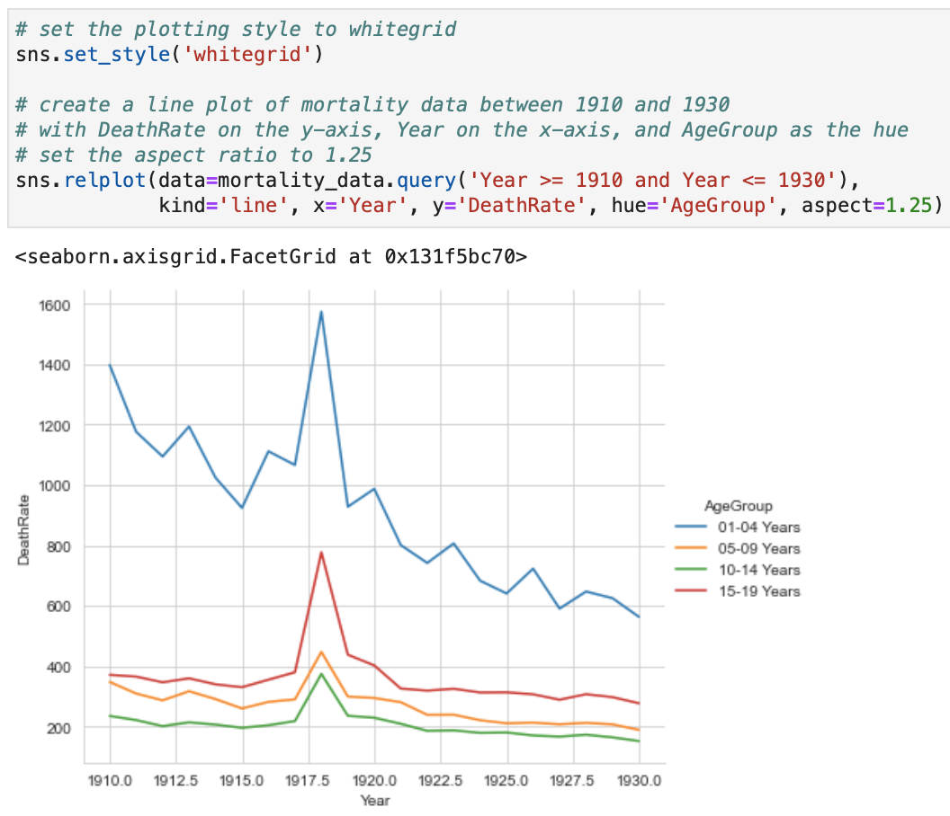
Set the Background Style
Several other values can be assigned to sns.set_style() to customise the style of the Seaborn plots:
"darkgrid": Sets a dark background with grid lines.
"whitegrid": Sets a white background with grid lines.
"dark": Sets a dark background with no grid lines.
"white": Sets a white background with no grid lines.
"ticks": Sets tick marks on the axes.
Notes:
**sns.set_style()** is a Seaborn function used to control the overall visual style of plots. It changes the appearance of the background, grid lines, axes, and other visual elements.
It is a global setting, meaning it affects all Seaborn plots created after you call it.
Darkgrid, ticks, dark, white

Slide 38
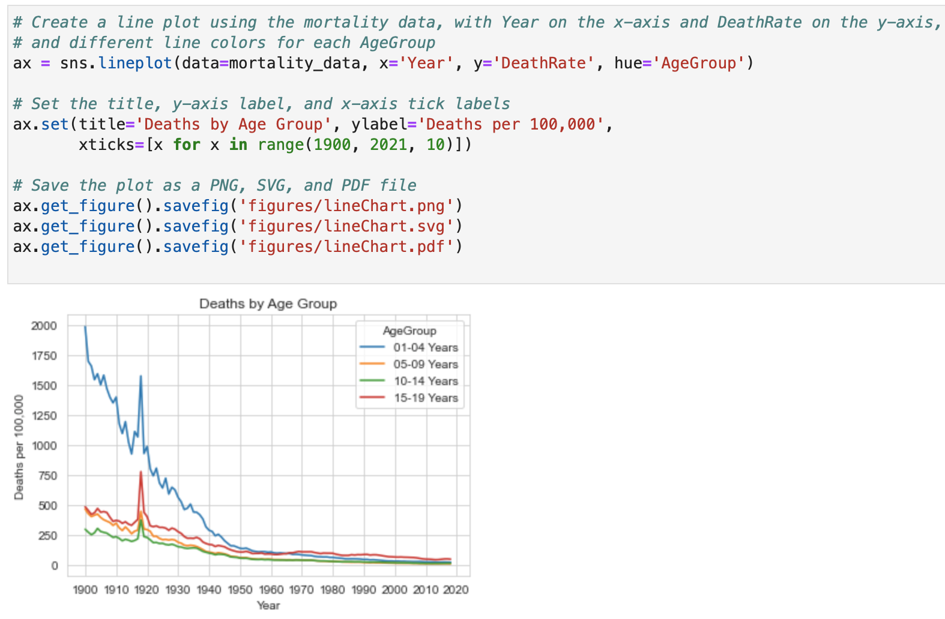
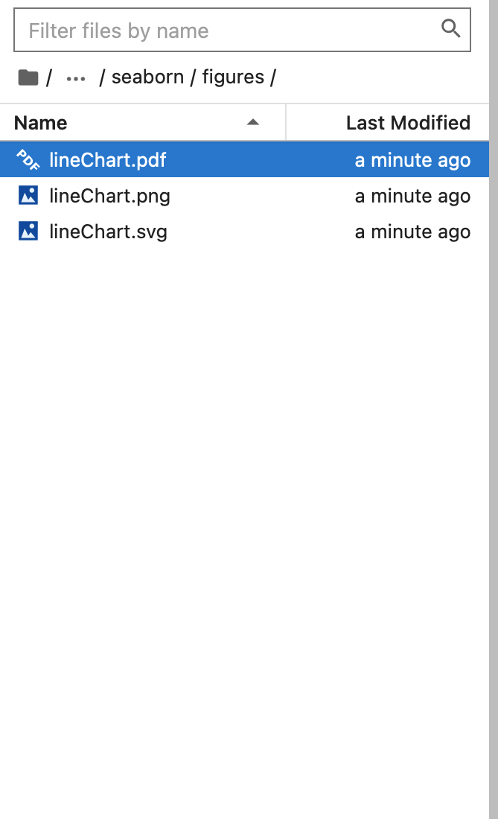
Save a Plot to a File
Notes:
bottom=0.35
Moves the bottom of the subplot area upward.
The value is a fraction of the figure height:
0 → very bottom of the figure
1 → top of the figure
Leave 35% of the figure height as empty space at the bottom. (creates space)

Slide 39
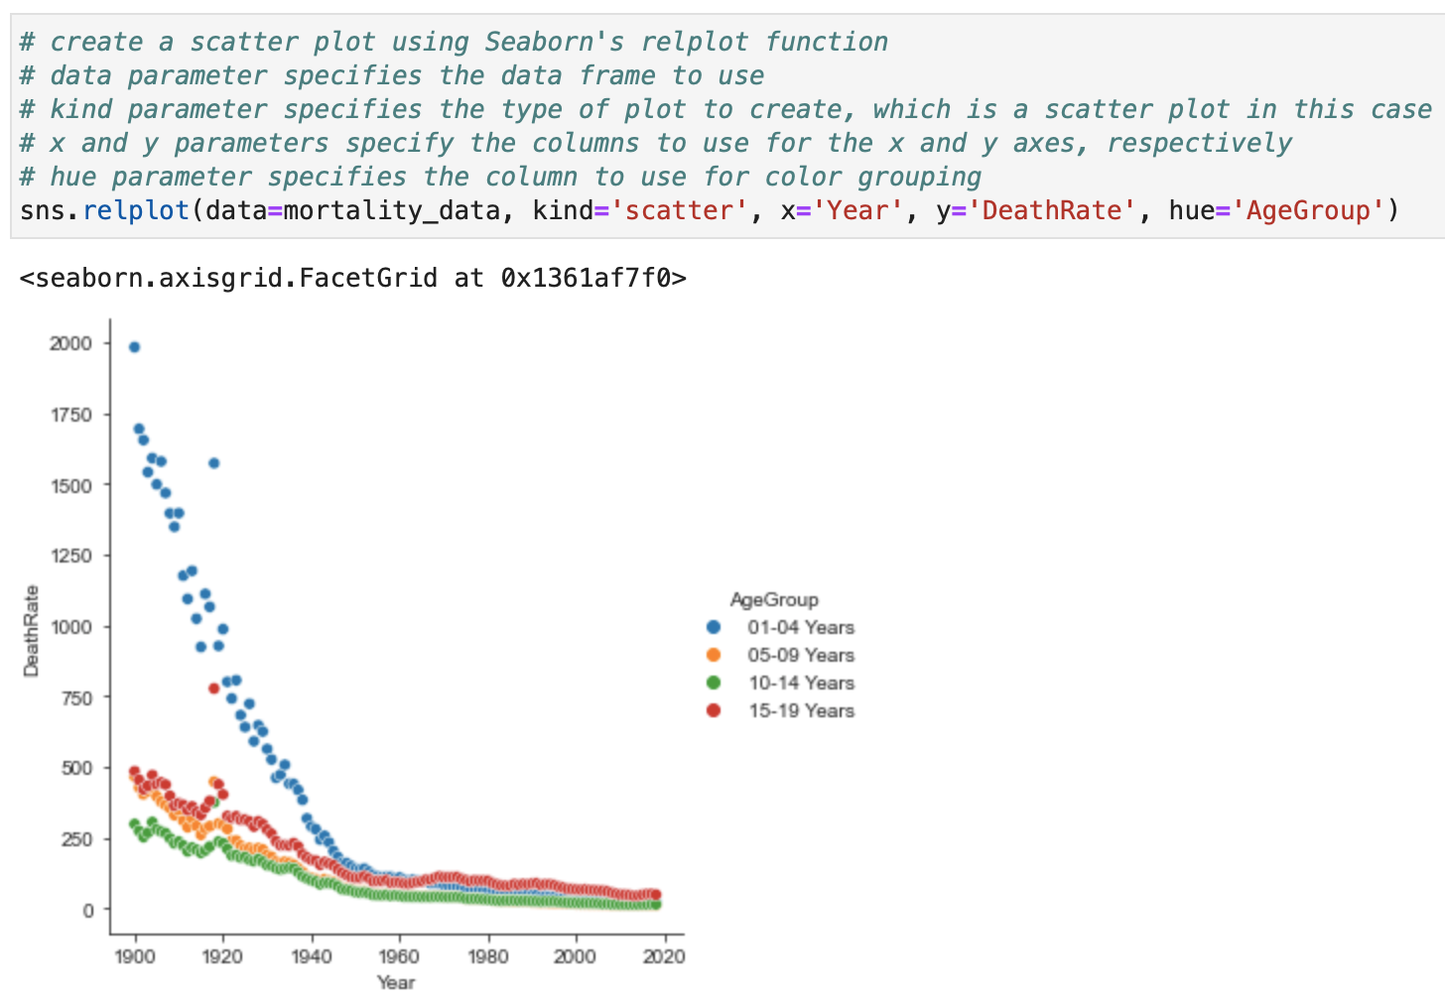
Scatter Plot

Slide 40
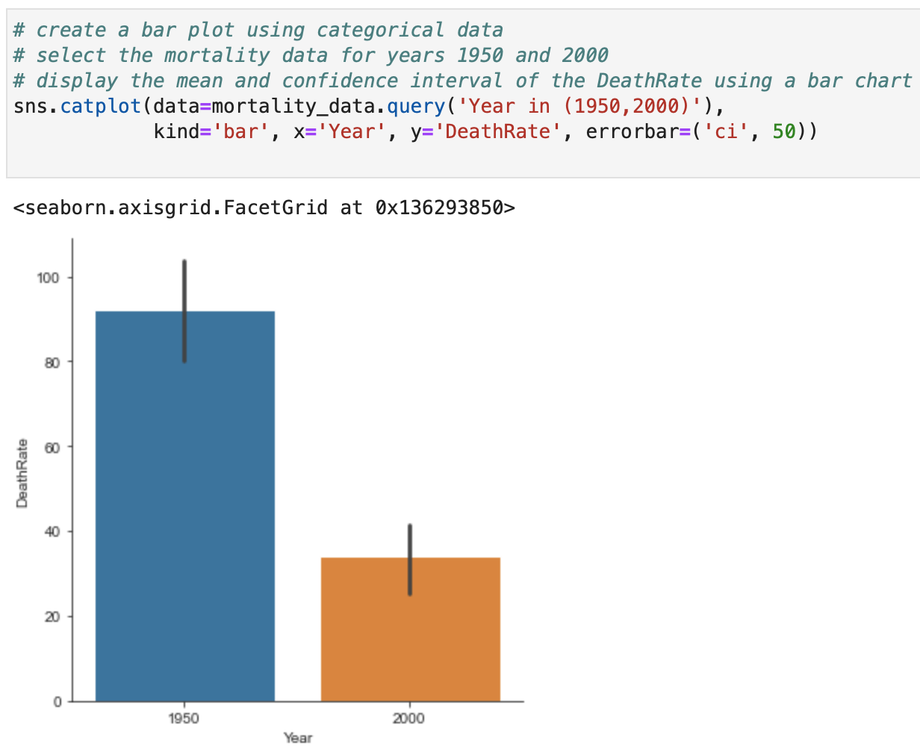
Bar Plot
"CI" stands for Confidence Interval.
CI=50: The length of the line indicates the range of values within which we can be 50% confident that the true mean of the DeathRate lies, for the years 1950 and 2000, respectively.
Notes:
In the code, "CI" stands for Confidence Interval. It's a statistical term that provides a range of values that is likely to contain the population parameter with a certain level of confidence. In this specific case, 'ci' is set to 50, which means that a 50% confidence interval is drawn for the mean death rate for the years 1950 and 2000.
dpi
Controls image resolution:
g → FacetGrid
g.fig → Figure
g.Axes → Axes array
ns.catplot() is a Seaborn figure-level function used to create categorical plots. It provides a single interface for visualizing the relationship between a categorical variable and one or more numerical or categorical variables.
Unlike functions such as sns.barplot() or sns.boxplot(), which create a single plot on one Axes, sns.catplot() creates an entire Figure and can easily generate multiple subplots using row, col, and hue.

Slide 41
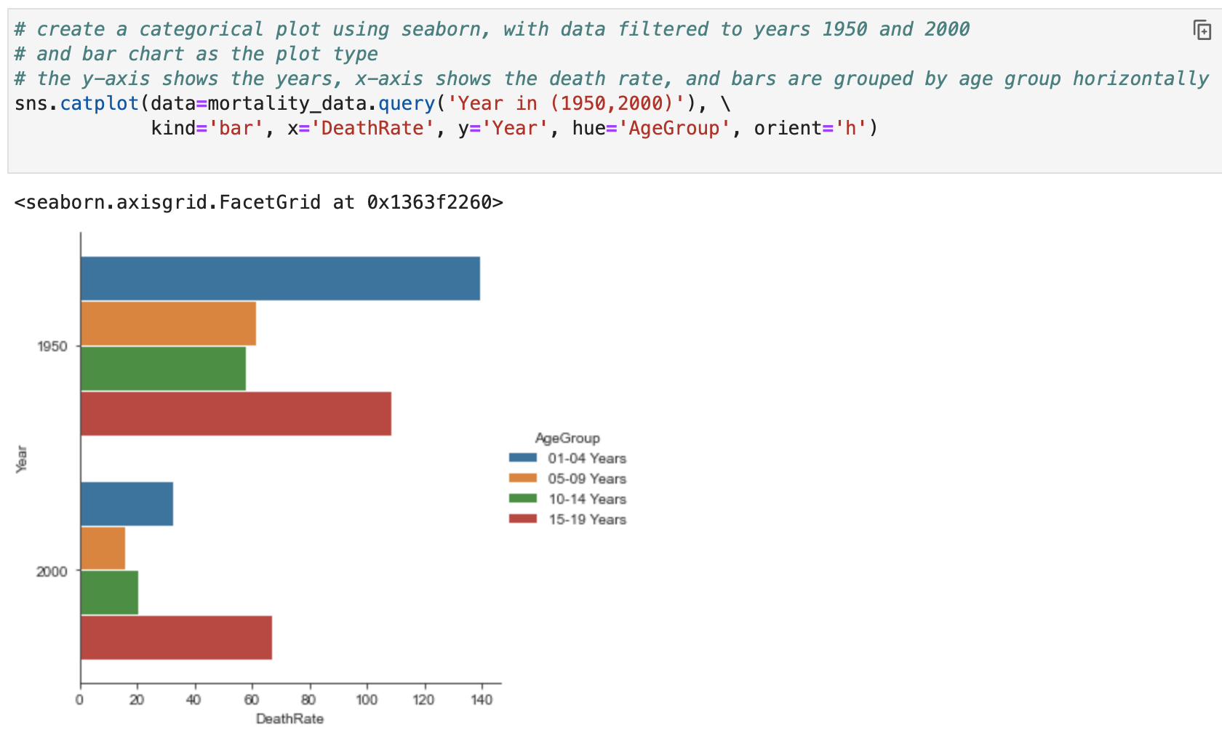
Bar Plot - Horizontal

Slide 42
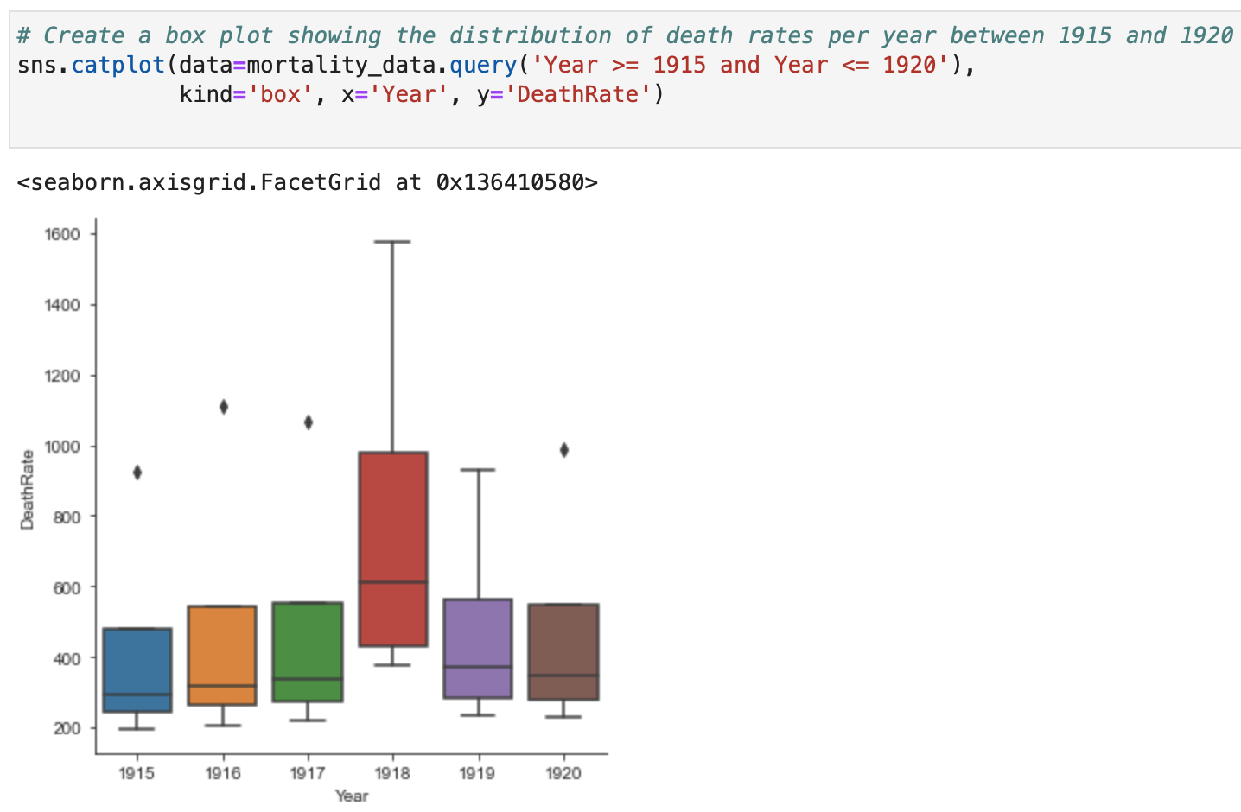
Box Plot

Slide 43
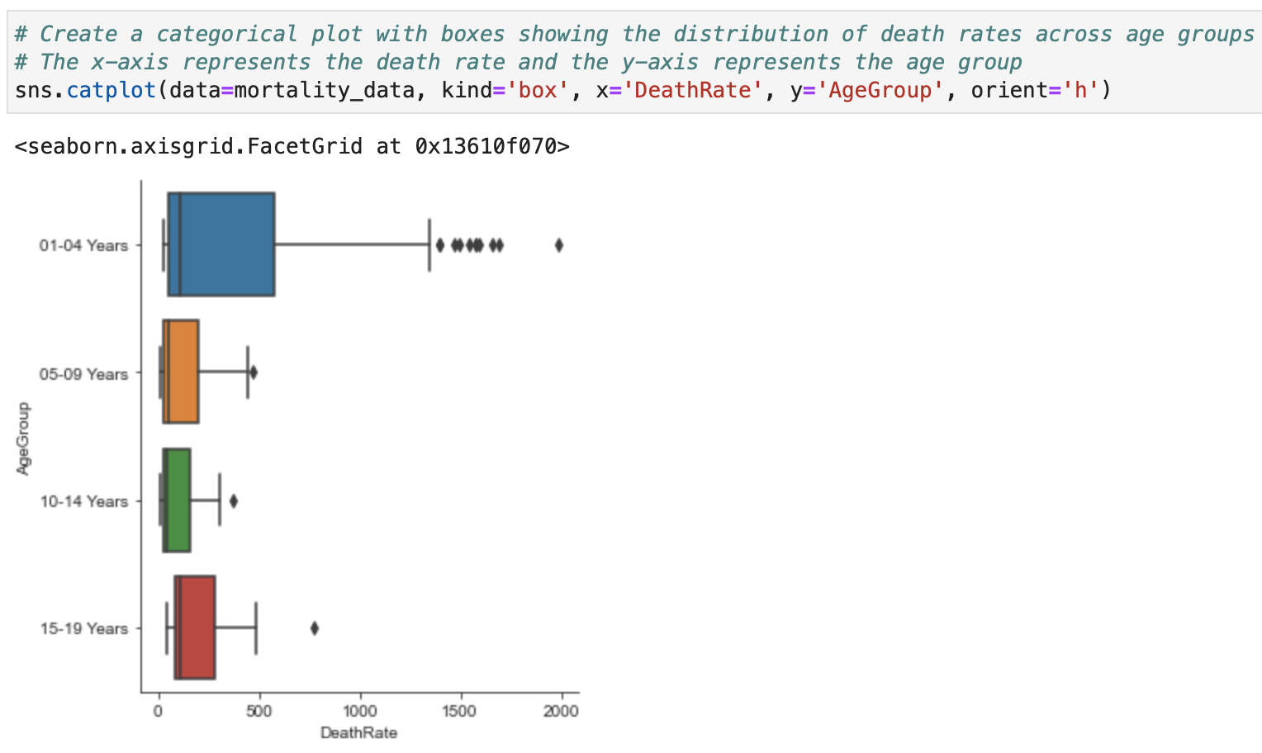
Box Plot - Horizontal

Slide 44
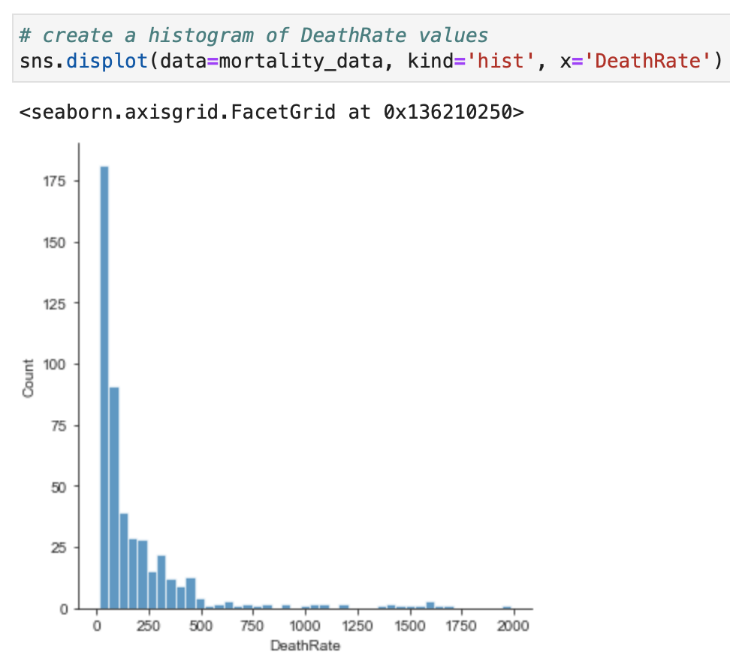
Histogram
Notes:
sns.displot() is a Seaborn figure-level function used to visualize the distribution of one or more numerical variables. It provides a unified interface for creating histograms, kernel density estimates (KDE), empirical cumulative distribution functions (ECDF), and combinations of these plots.
Like sns.relplot() and sns.catplot(), sns.displot() returns a FacetGrid, allowing you to easily create multiple subplots with row, col, and hue.

Slide 45
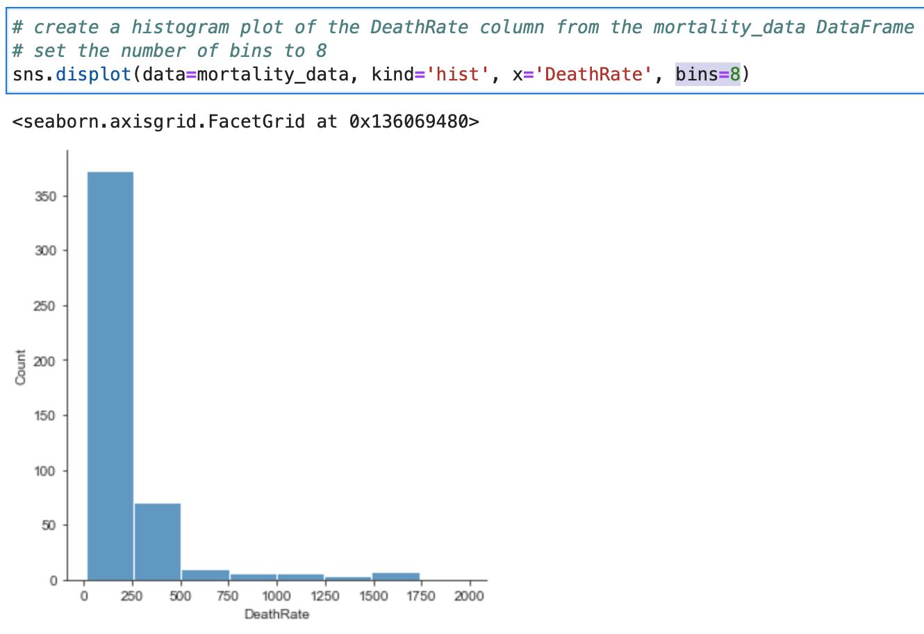
Histogram – Custom Bins
Notes:
Kind=“kde” This shows only the smooth density curve without histogram bars.
Vertical axis is always frequency or count or the number of itmes in each bin or bar.

Slide 46
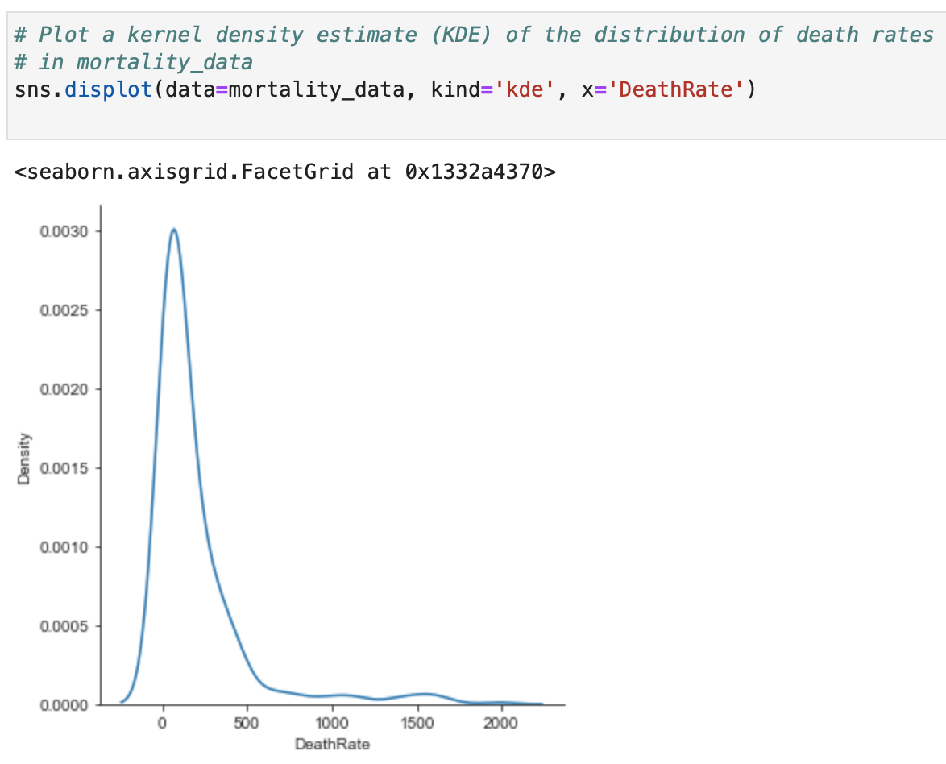
Density Function- Kernel Distribution Estimate

Slide 47
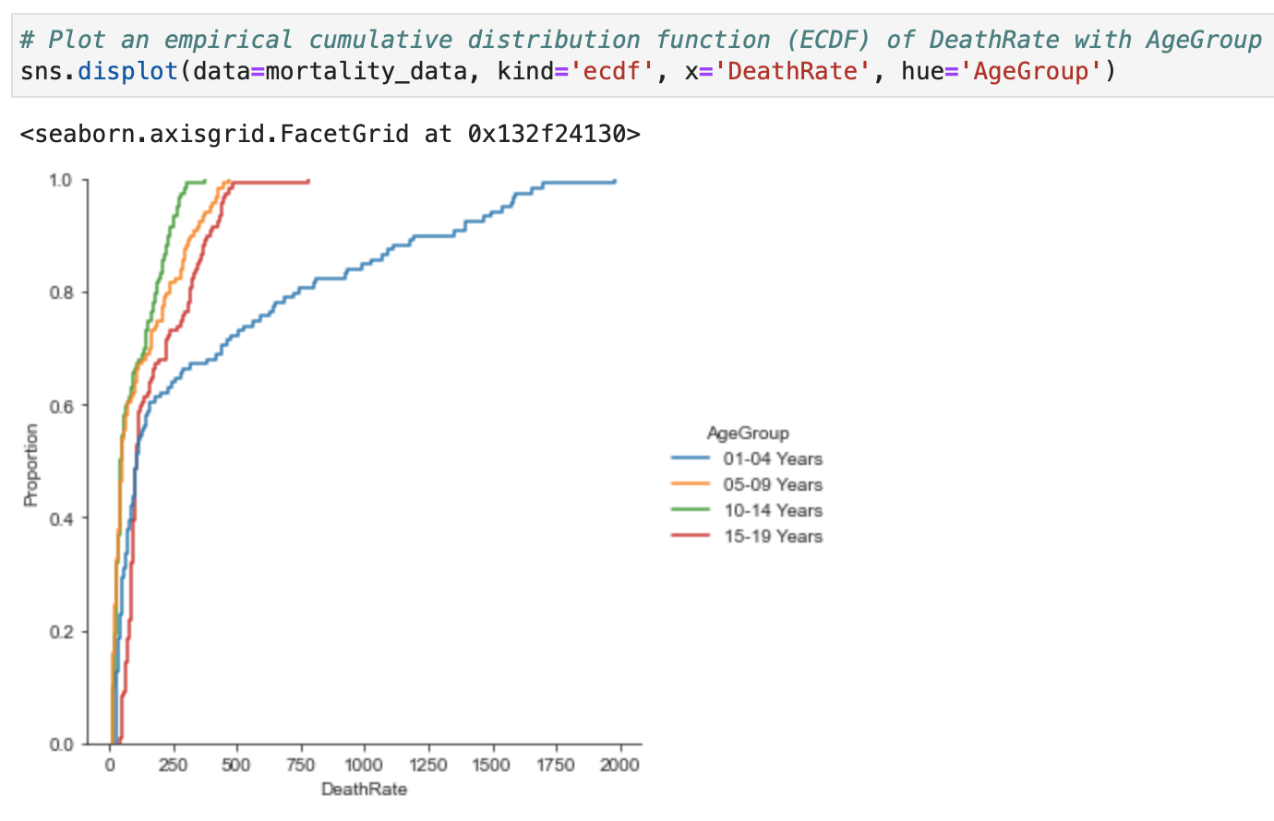
Empirical Cumulative Distribution Function
The x-axis represents the values of the variable.
The y-axis represents the proportion of data points that have a value less than or equal to the corresponding x-value.
The plot is useful for visualising the distribution of a variable and identifying important features such as the median and the range of the data.

Slide 48
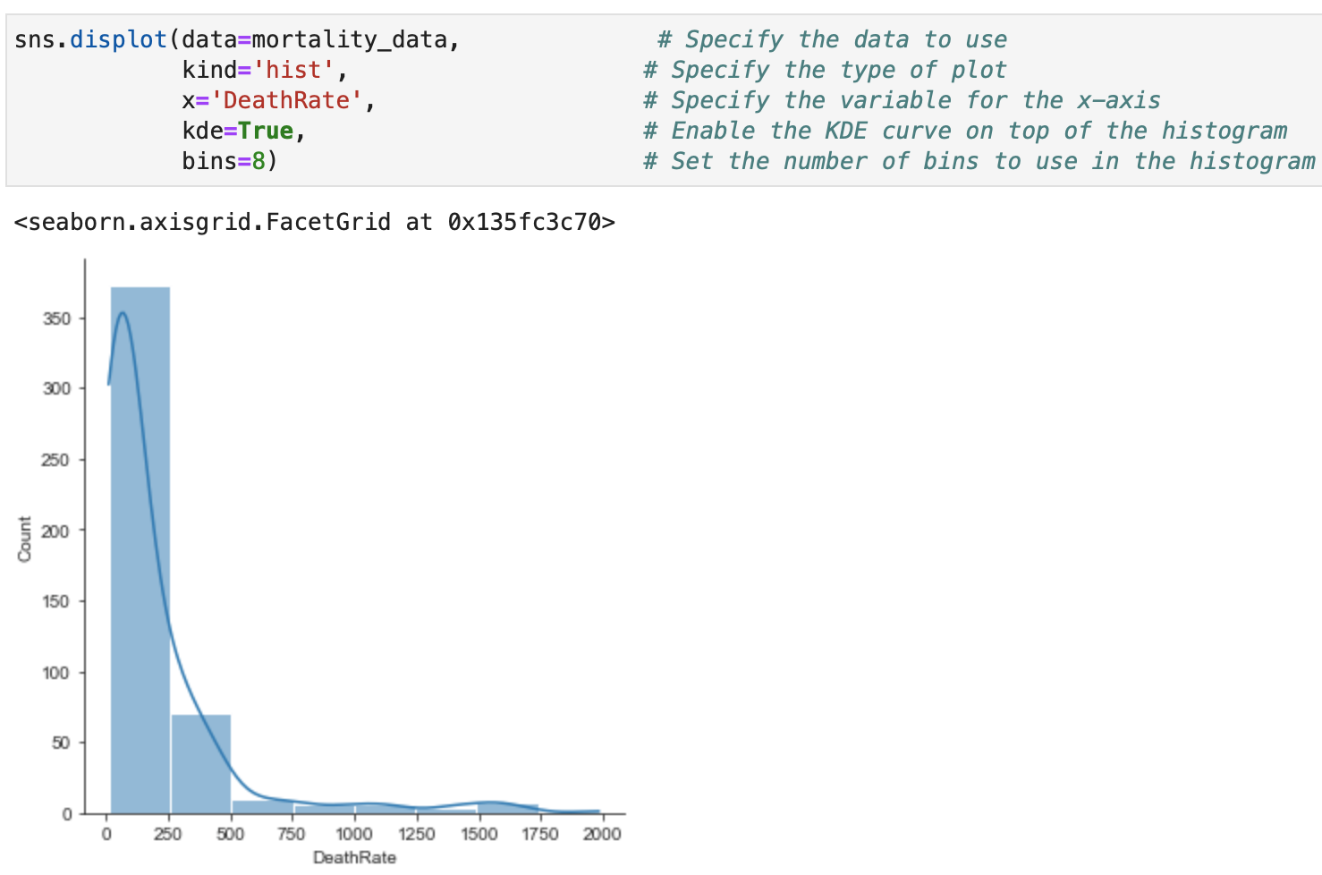
Enhanced Distribution Plots
Notes:
When should you use sns.displot()?
Use sns.displot() when you want to:
Explore the distribution of one or more numerical variables.
Check for skewness, spread, or multiple peaks (modes).
Compare distributions across groups using hue, row, or col.
Create multiple distribution plots in a single figure.
If you only need a single histogram or KDE plot, use an axes-level function like sns.histplot() or sns.kdeplot(). If you need faceted distribution plots, sns.displot() is the recommended choice.

Slide 49
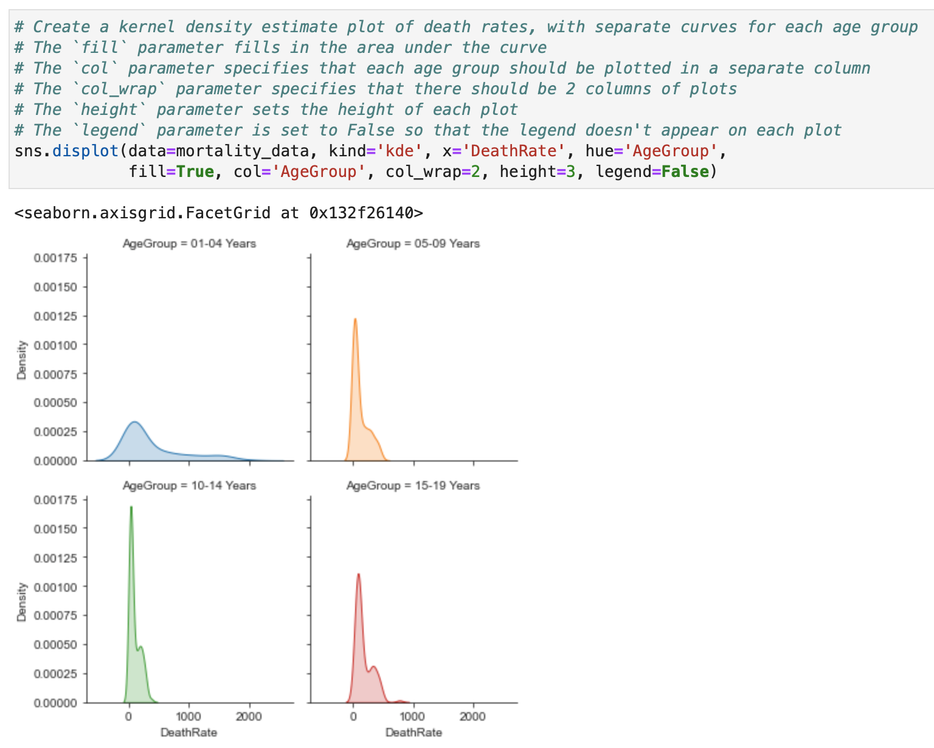
Enhanced Distribution Plots (Cont.)

Slide 50
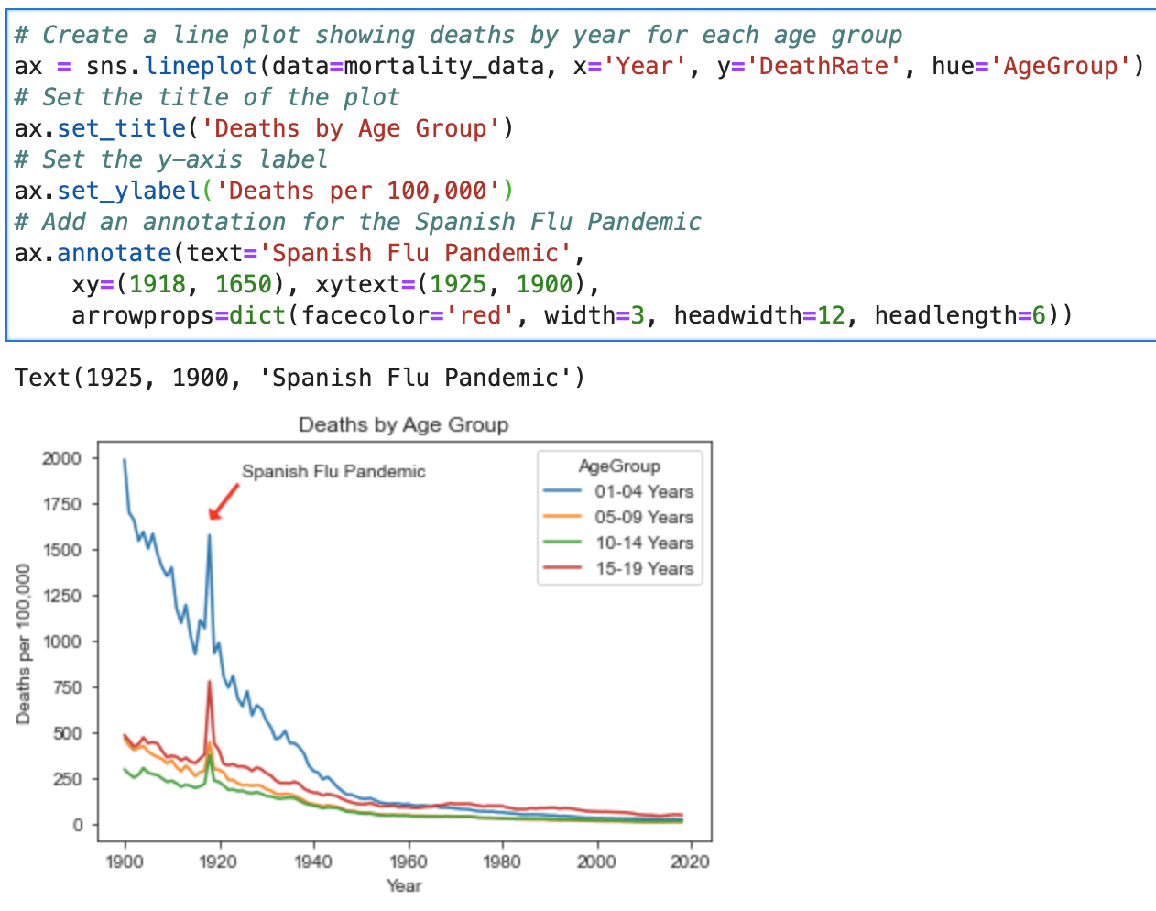
Annotate a Plot
Notes:
sns.lineplot()
Type: Axes-level function
Returns: A Matplotlib Axes object
Creates: A single line plot on one set of axes
Can be placed: Inside existing Matplotlib figures and subplots
ax.set() is a convenient Matplotlib method that lets you set multiple axes properties in one line. It is often used instead of calling set_title(), set_xlabel(), etc., separately.
ax.annotate() is a Matplotlib method used to add annotations (text and optional arrows) to a plot. It is especially useful for highlighting important data points.
Xy The point being annotated (where the arrow points)
Xytext The location where the text will appear
arrowprops={"arrowstyle": "->"}
Arrowprops Controls the arrow's appearance (style, color, width, etc.)

Slide 51
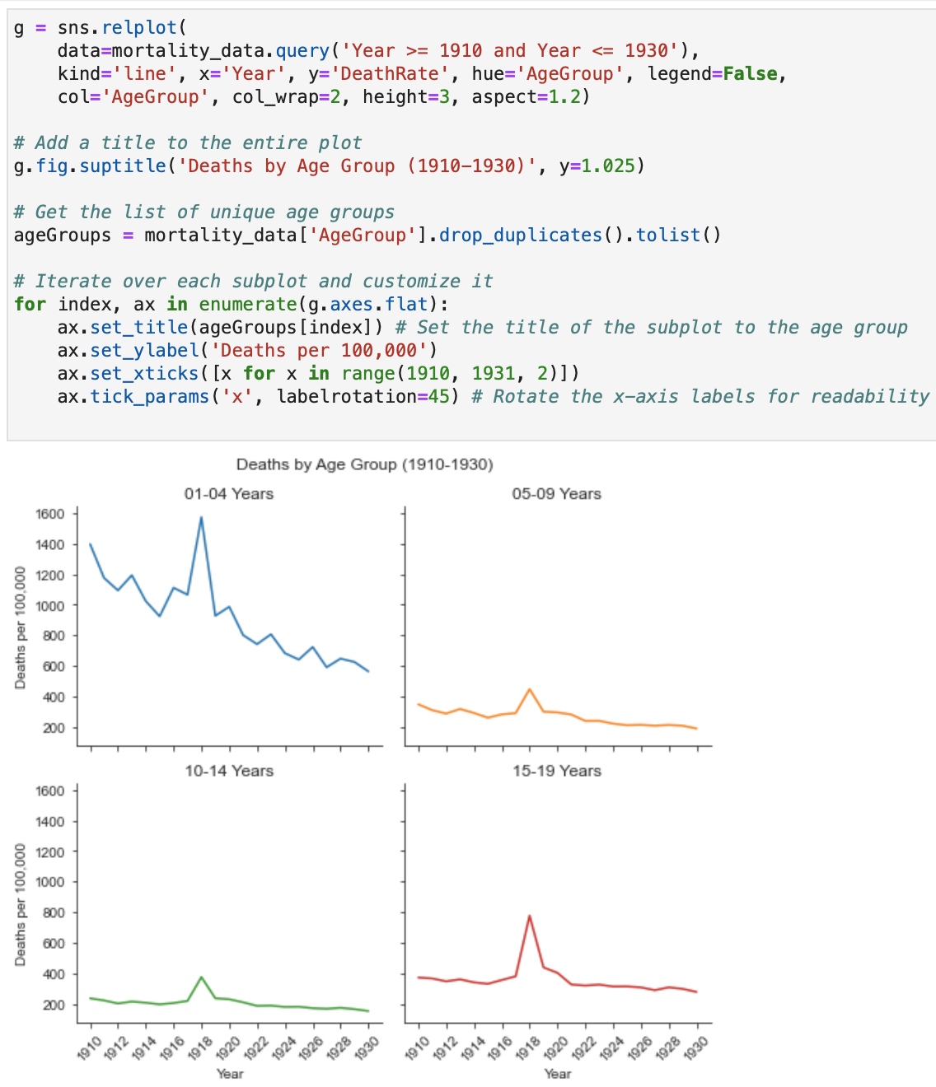
Custom Titles for Subplots

Slide 52
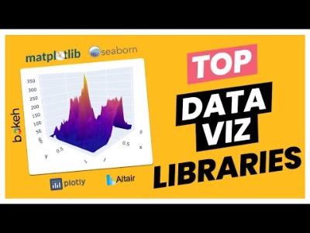
Movie Time ☺

Slide 53
References
Data science from scratch: first principles with Python, Joel Grus, O'Reilly Media, 2019
Python for Data Analysis: Data Wrangling with Pandas, NumPy, and IPython, Wes McKinney, O'Reilly Media, 3rd edition, 2022.
Python Data Science Handbook: Essential Tools for Working with Data, Jake Vanderplas, O'Reilly Media, 2022
Murach’s Python for Data Analysis, Scott McCoy, Mike Murach & Associates, Incorporated, 2021.
Intro to Python for Computer Science and Data Science: Learning to Program with AI, Big Data and The Cloud, Paul Deitel, Pearson Education Limited, 2021.
ChatGPT

Slide 54

End of lecture …

